Slide 1
Content Management System(CMS)

Slide 2
What is CMS?
A content management system (CMS) is an application that is used to manage web content, allowing multiple contributors to create, edit and publish. Content in a CMS is typically stored in a database and displayed in a presentation layer based on a set of templates.
A CMS may serve as a central repository for content, which could be, textual data, documents, movies, pictures, phone numbers, and/or scientific data.

Slide 3
Features of CMS
Content creation (allows users to easily create and format content)
Content storage (stores content in one place, in a consistent fashion)
Workflow management (assigns privileges and responsibilities based on roles such as authors, editors and admins)
Publishing (organizes and pushes content live)

Slide 4
Types-CMS
Web Content Management System (WCMS): Organizations that deliver most of their content to the internet, such as on user guides on their website, rely on a WCMS because it’s designed for sending content to the web.
Digital Asset Management System (DAM): This content management software is dedicated to graphic and multimedia management — not text. Graphic design, photography, and film companies often benefit from a DAM system as they deal exclusively in visual products.
Enterprise Content Management System (ECM): This type of content management system takes a global approach to managing content. It can handle your emails, documents, instant messaging, and other electronic files.

Slide 5
Cont..,
Document Management System (DMS): A DMS is a document manager. Instead of focusing on a content’s details, it concentrates on content at the file level (eg, Word or PDF documents). A DMS, for example, tracks who modifies documents, but it also controls who can access and update a document. Numerous organizations use a DMS to ensure essential content, such as branding guidelines, remain unedited by lower-level staff.
Component Content Management System (CCMS): The CCMS is more granular than a DMS. Unlike a DMS, our CCMS focuses on your content’s details rather than the files themselves. Components include conceptual topics, procedures, sensitive information (cautions and warnings), product descriptions, and many others.

Slide 6
Workflow-CMS
Designing content template, for example web administrator designs webpage template for web content management.
Creating content blocks, for example, a web administrator adds empower CMS tags called "content blocks" to webpage template using CMS.
Positioning content blocks on the document, for example, web administrator positions content blocks in webpage.
Authoring content providers to search, retrieve, view and update content.
Publishing content providers to publish the updated content.

Slide 7
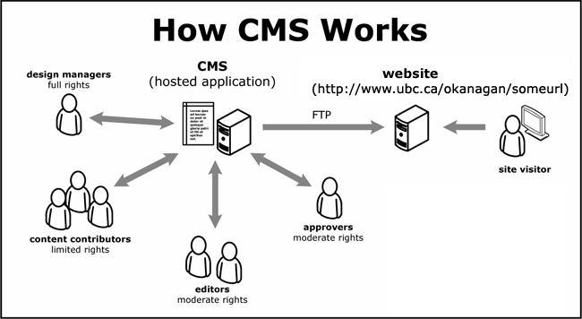
Working-CMS

Slide 8
1) Designing content
Content from the Web authors are received by the CMS, the Web Template are designed based on the given content by the Template Designers.
The Templates are designed by the Web Administrator Design.

Slide 9
2) Creating content blocks
Content blocks are text, HTML or Markdown blocks that can be edited separately from the page or layout. They are designed to hold static content only and support basic templating variables. Partials are more flexible and should be used for generating dynamic content.

Slide 10
3) Authoring content
A web content management system (WCMS) is a software content management system (CMS) specifically for web content. It provides website authoring, collaboration, and administration tools that help users with little knowledge of web programming languages or markup languages create and manage website content.

Slide 11
4) Publishing content
After the Approval of the Web Author, the Updated Content are Published through the Intranet and Extranet. The Web Surfers can view the Content published.
The Content are published only after the Approval of the Web authors. If the Design is Rejected, the content are again updated based on Author requirement and then published on Internet.

Slide 12
Elements of CMS
Content Management Application(CMA)
Content Delivery Application(CDA)

Slide 13
Content Management Application(CMA)
A content management application (CMA) is the front end component of a content management system (CMS). The CMA interface allows users to create and manage corporate or website content.

Slide 14
Content Delivery Application(CDA)
Content Delivery Application (CDA) (sometimes called content distribution , content distribution delivery , or content caching ) is the service of copying the pages of a Web site to geographically dispersed server and, when a page is requested, dynamically identifying and serving page content from the closest server to the user, enabling faster delivery.

Slide 15
CMS-Software
WordPress.
Drupal.
Joomla!
Expression Engine.
Text Pattern.
Radiant CMS.
Cushy CMS.
Silver Stripe.

Slide 16
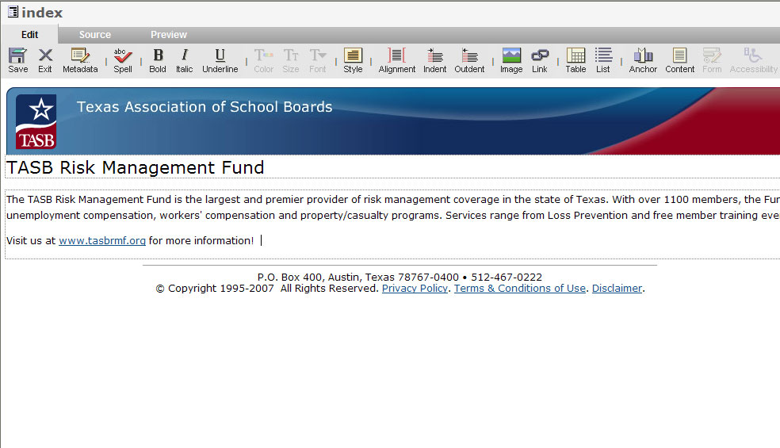
CMS Template Example

Slide 17
Thank You

